Slide 1


Slide 2
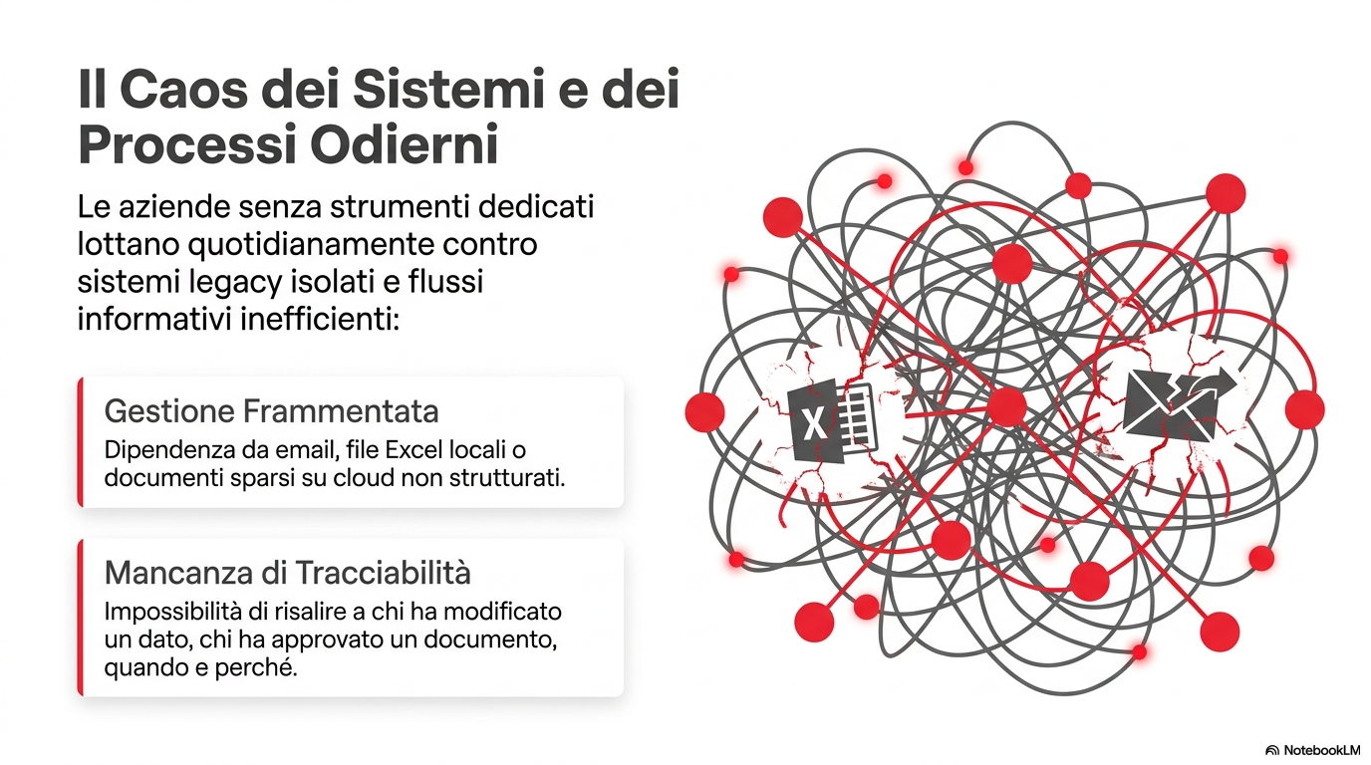

Slide 3
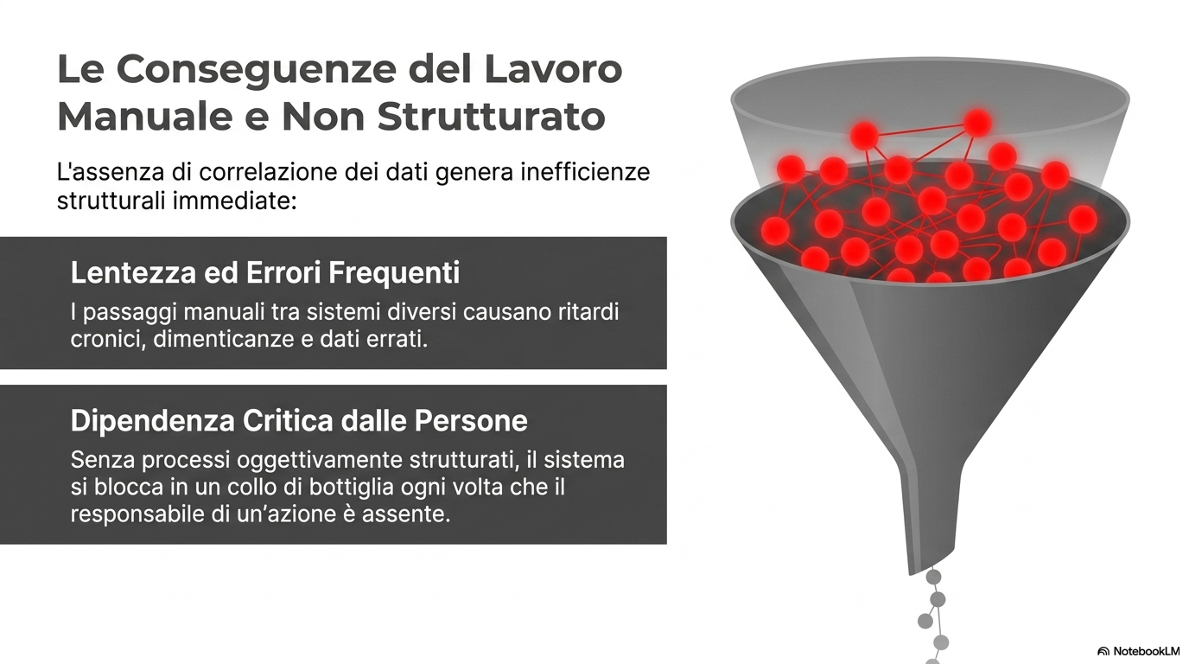

Slide 4
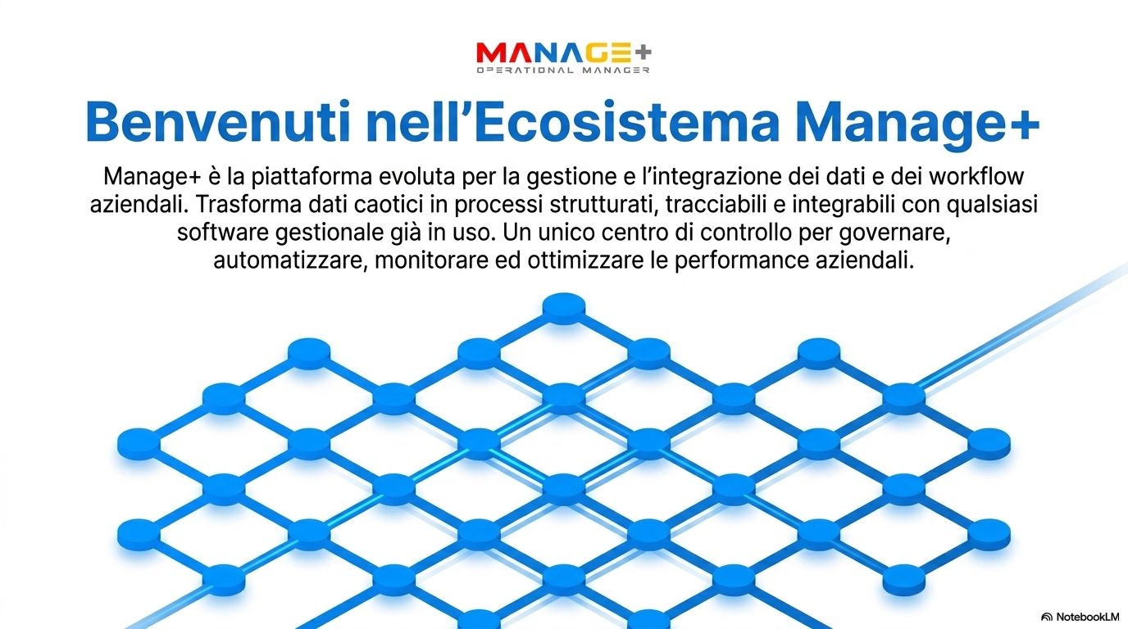

Slide 5
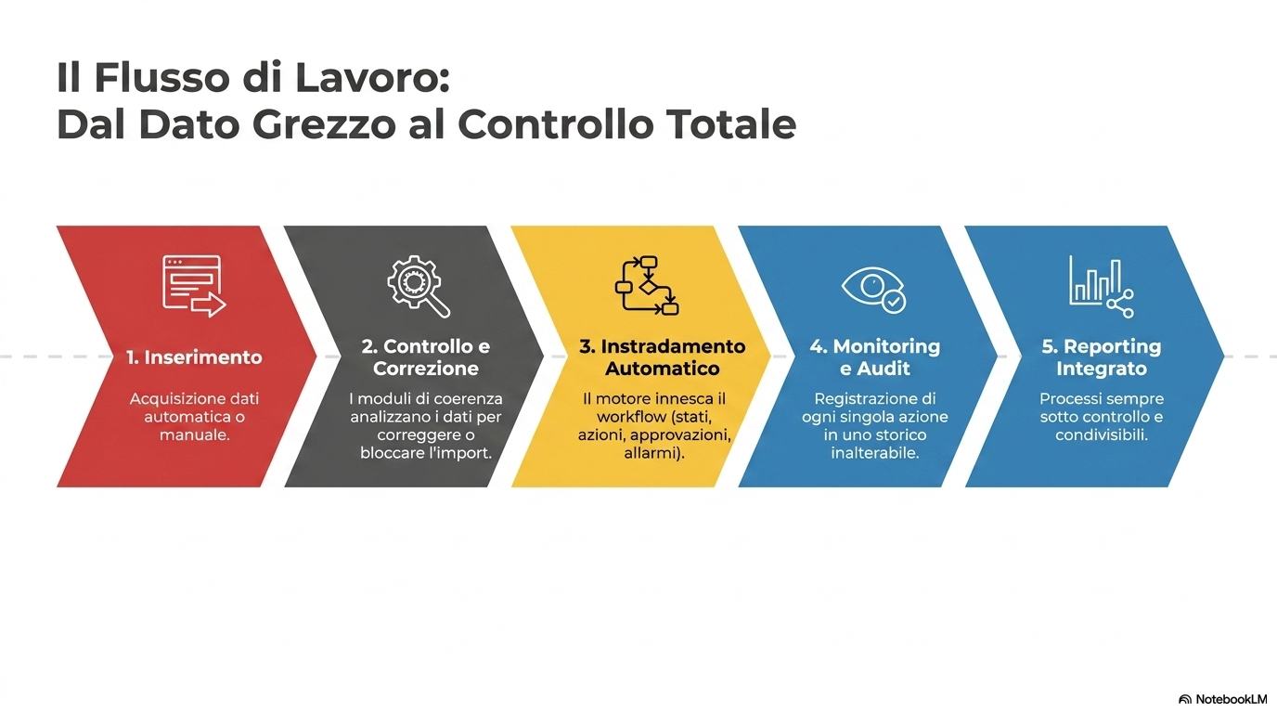

Slide 6
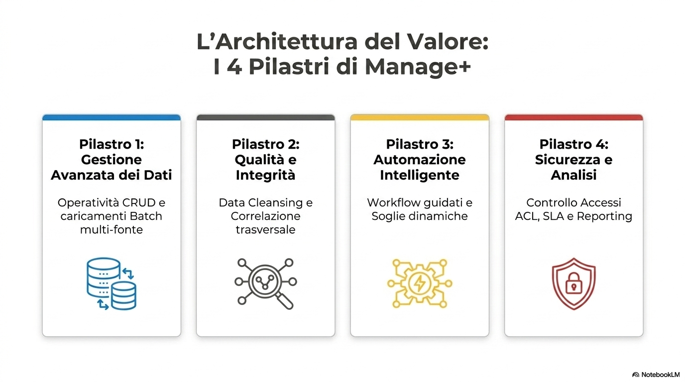

Slide 7
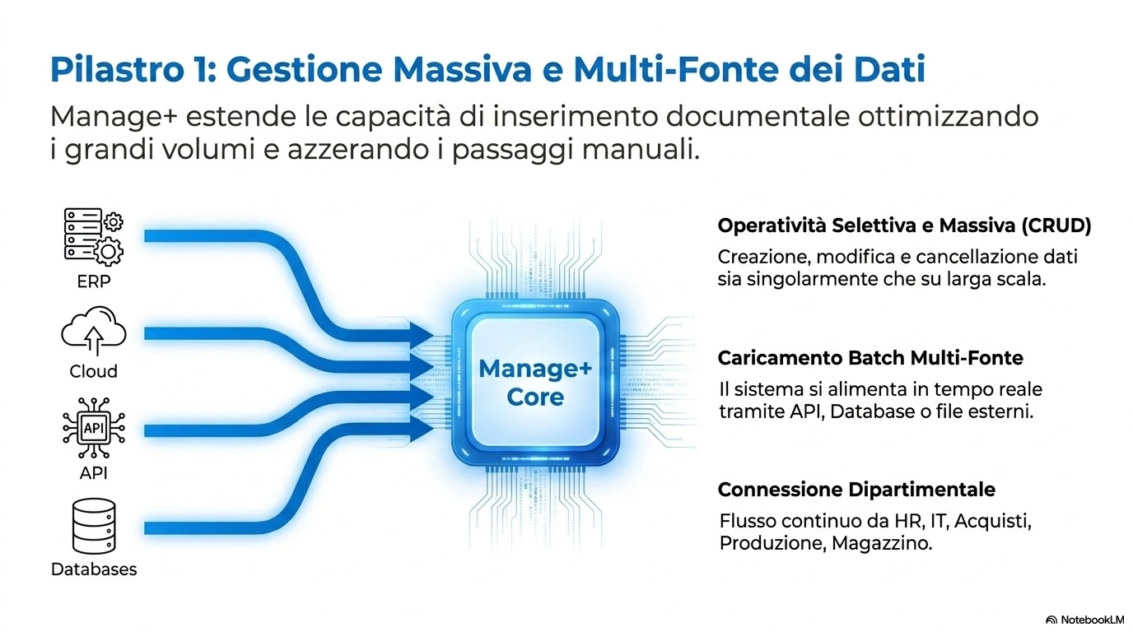

Slide 8
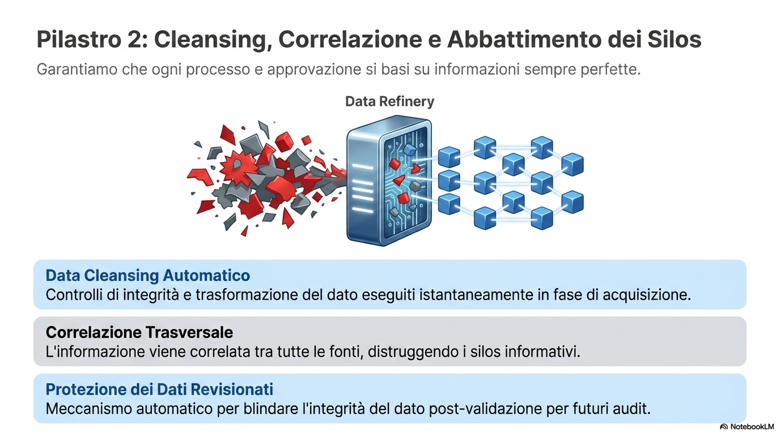

Slide 9
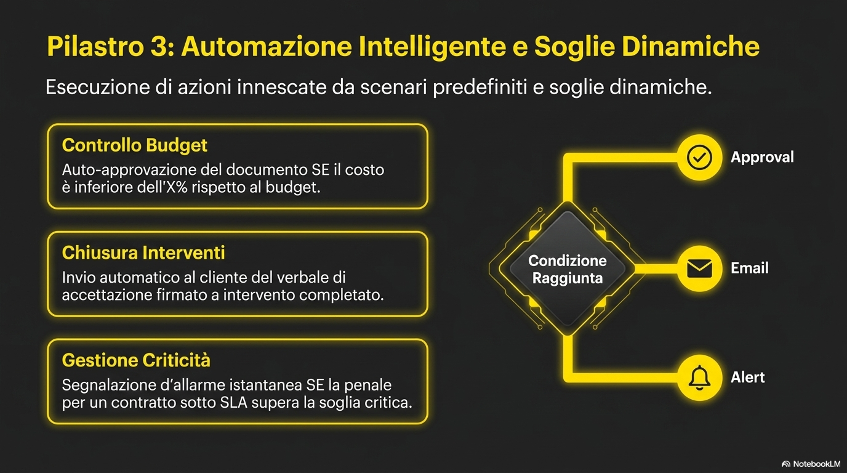

Slide 10
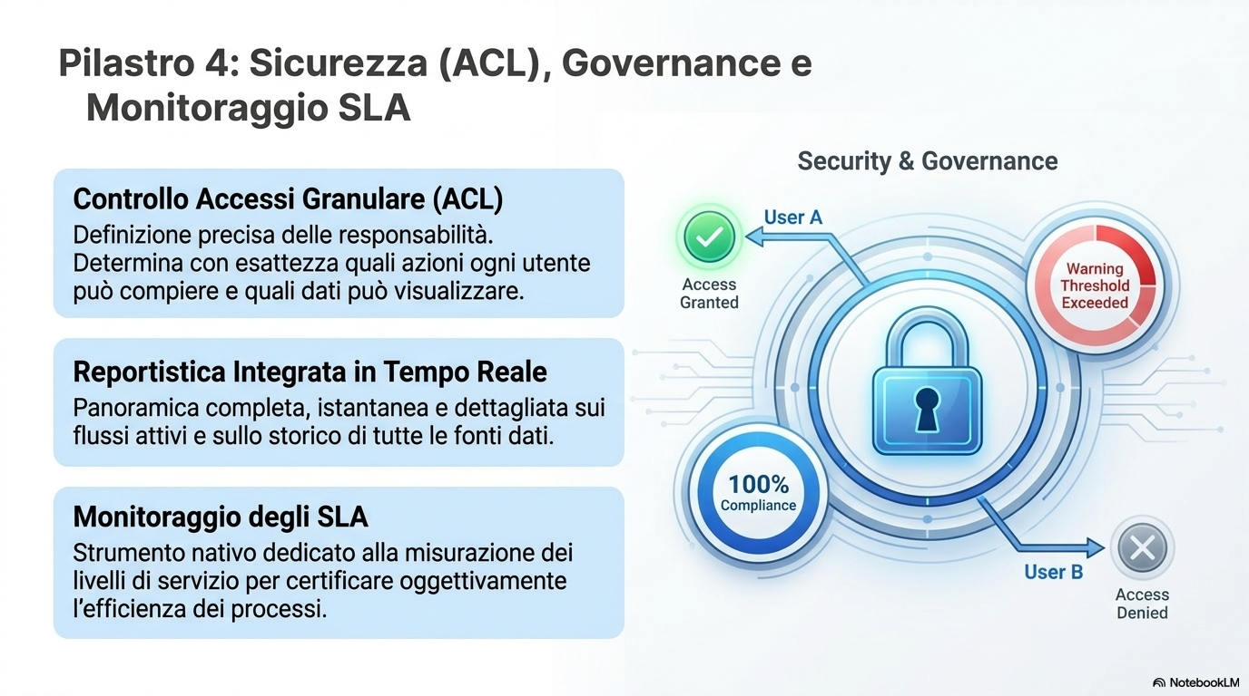

Slide 11
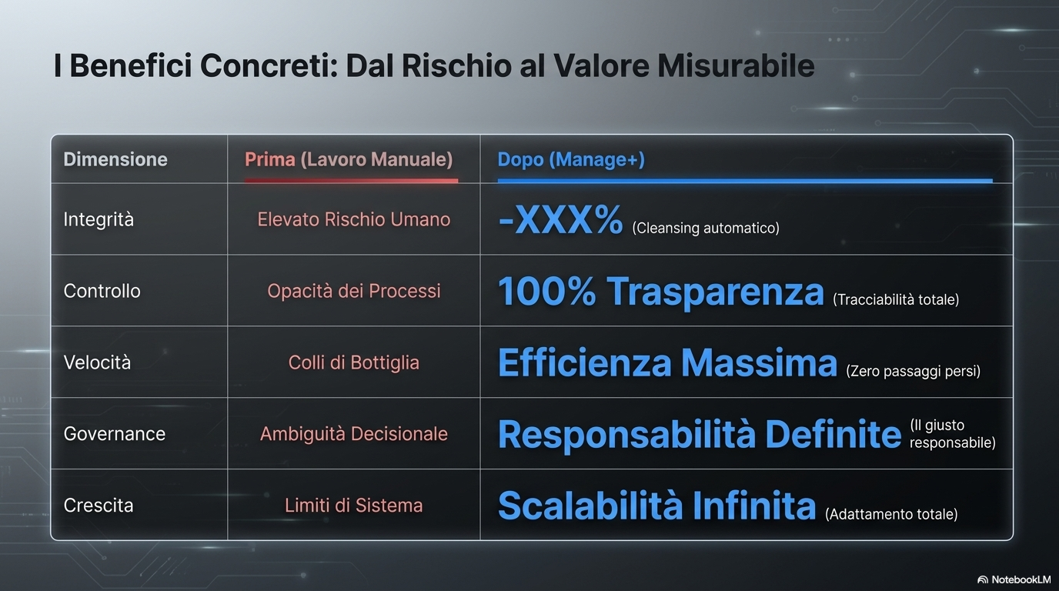

Slide 12
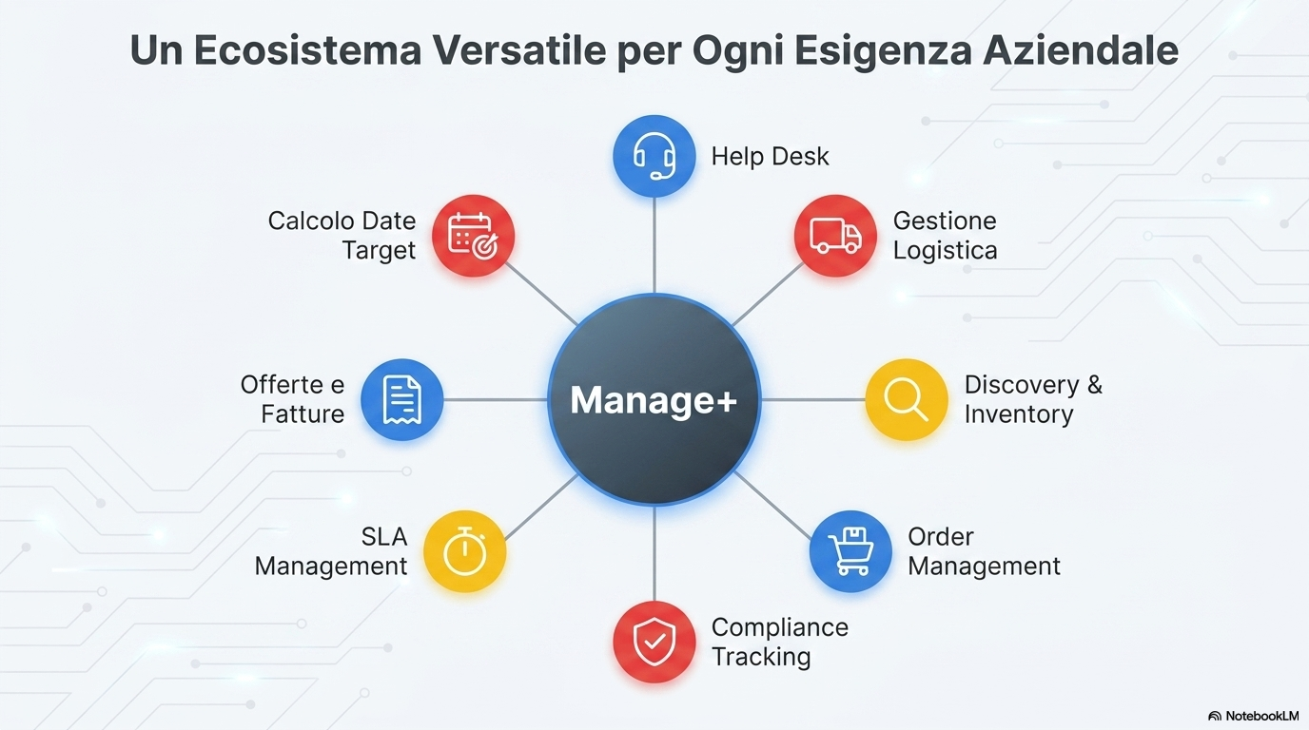

Slide 13
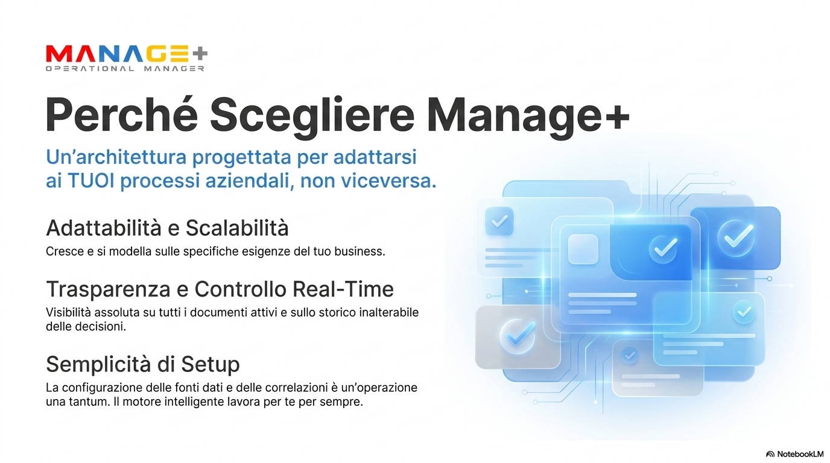

Slide 14

Bioss Consulting S.r.l.
Via Panfilo Castaldi n, 8 - 20124 Milano
info@biossconsulting.com
www.biossconsulting.com
Clear Axess SAGL
Via alla Campagna 4 - 6900 Lugano
info@clearaxess.com
www.clearaxess.com

